Slide 1
ABSOLUTE HELIKITE DEPLOYMENT OPTIONS
Munich Feb 2013
ALLSOPP HELIKITES LIMITED

Slide 2
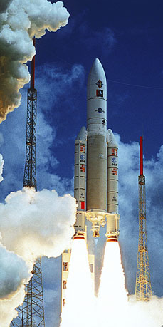
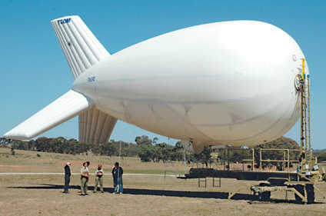
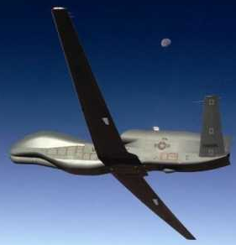
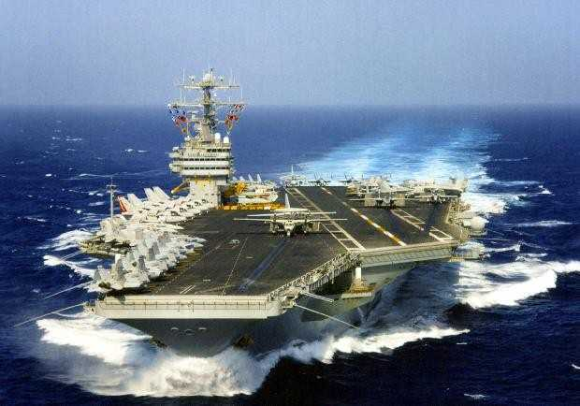
USUAL AIRBORNE USV RADIO-RELAY PLATFORMS Extremely hard to operate and pay for.
Expensive and difficult airborne platforms are often touted as suitable for unmanned vehicle radio-relay, however in reality they are seldom practical.

Slide 3
HELIKITE - Altitude From Understanding
Wind pushes Helikites strongly up, rather than down as with other aerostats.
All Helikites, whatever size, fly in no wind and also in gales – with no adjustment.
WIND LIFT
Considerable top-frontal lift creates high wind stability.
HELIUM LIFT
BALLOON
WIND LIFT
SAIL
KEEL
STIFF SPINE
FLYING LINE
Helikites harness the wind that other aerostats fight.

Slide 4
The size, cost, deployment-time of the Helikite aerostat, is directly related to the weight of the ABSOLUTE payload.
The payload is only made once, whereas the Helikite may need to be deployed many times in times of stress.
Therefore the weight of the airborne payload is critical.

Slide 5
PAYLOAD POSITIONS ON THE HELIKITE
Very lightweight payload such as lightweight antennas, strobe-lights, small sensors etc, can be put all over the Helikite.
Heavy payload is different. When put in the correct place, significant payload actually increases Helikite stability.
Put in the wrong place it reduces stability.
Luckily there are a number of excellent places to put payload on Helikites.

Slide 6
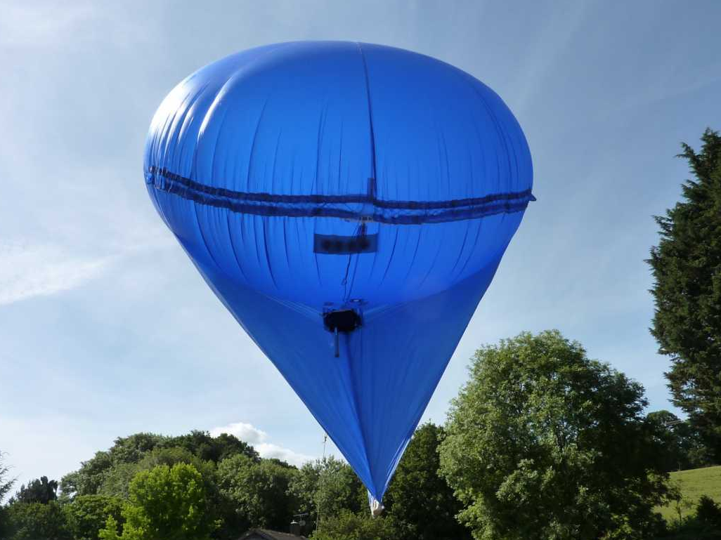
5m3 DESERT STAR HELIKITE
UNDER BALLOON:
For items not needing easy access, such as electronics. Shielded from rain and dust etc.

Slide 7
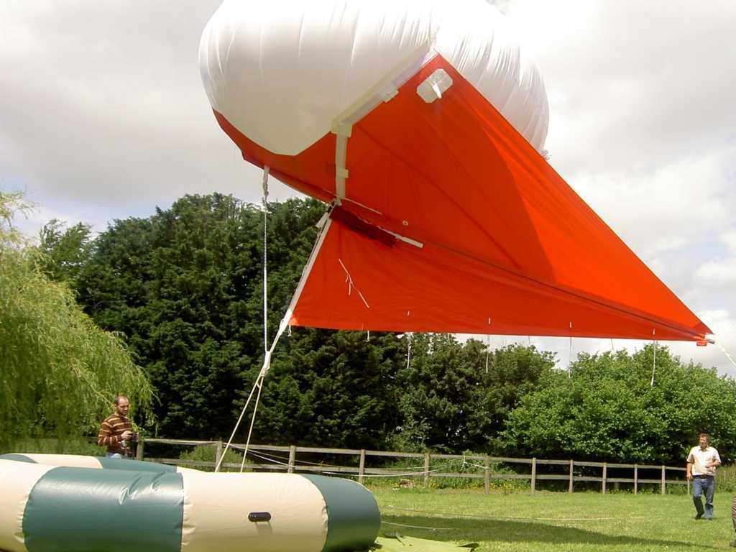
34m3 SKYHOOK HELIKITE
TOP-FRONT OF KEEL: For items needing fast, easy, access such as batteries.

Slide 8
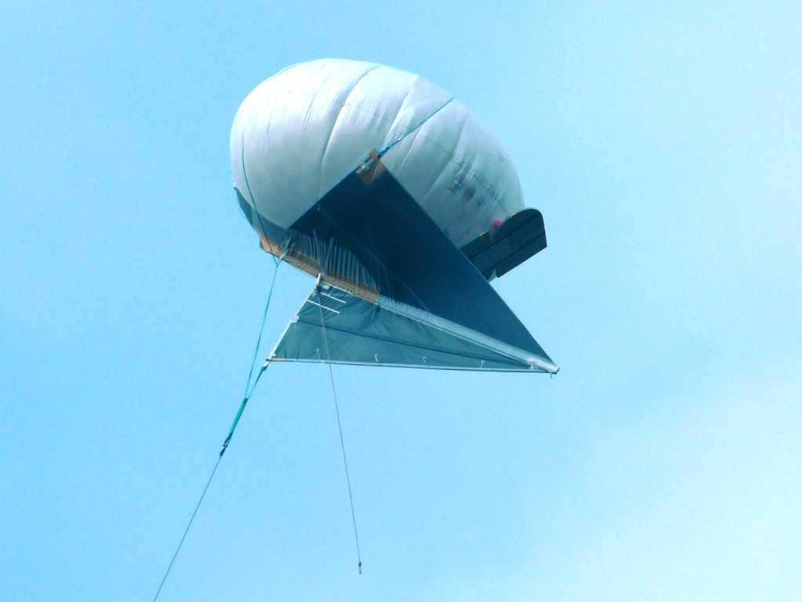
64m3 DESERT STAR HELIKITE
BEHIND BALLOON: For bulky, lightweight objects such as antennas.

Slide 9
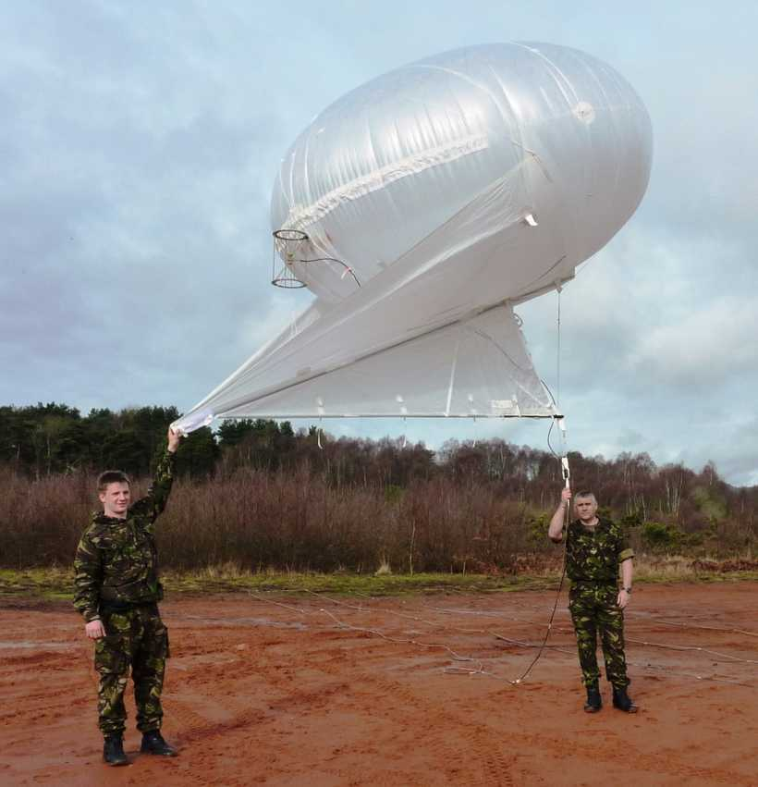
10m3 DESERT STAR HELIKITE FOR ROYAL MARINES SHIP-TO-SHORE RADIO-RELAY
BEHIND BALLOON: For bulky, lightweight objects such as antennas.
ON FLYING LINE:
For lightweight cable or fibre optic

Slide 10
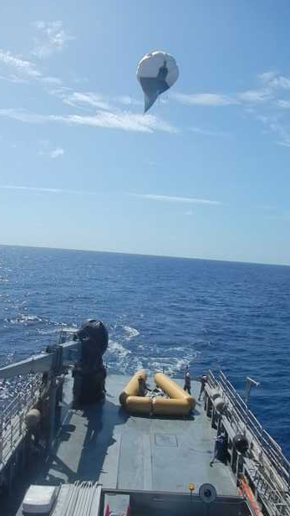
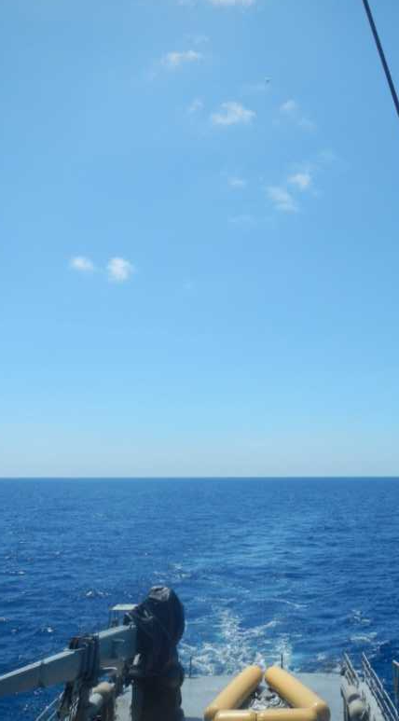
Fibre-optic flying line can go to thousands of feet if required when using the correct winch design
64m3 Desert Star Helikite flying from moving ship.

Slide 11
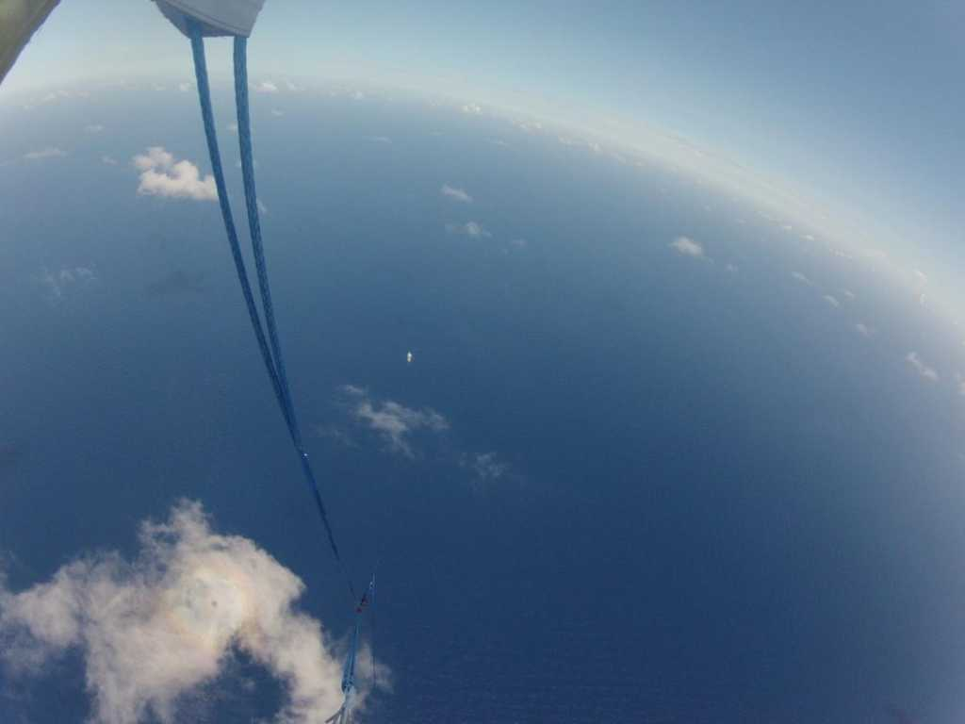
View from 64m3 Desert Star Helikite lifting 5000ft of fibre-optic cable from ship below.
Notes:
5000ft view

Slide 12
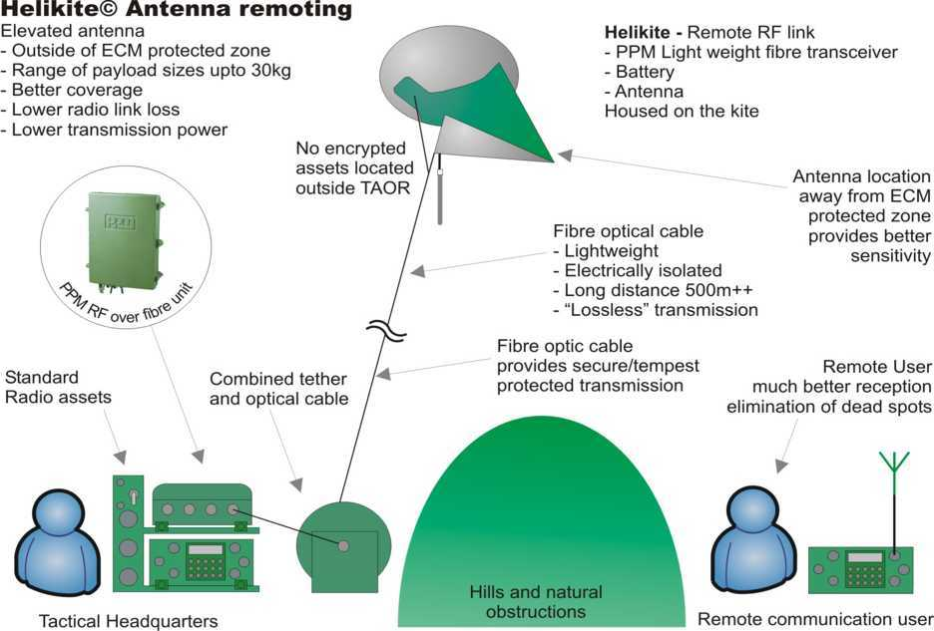
RF-Over-Fibre + Helikite is General Dynamics’ preferred solution for range extension to the UK MOD Bowman Radio. Possibly suitable for ABSOLUTE.

Slide 13
POSITION OF ABSOLUTE PAYLOAD ELEMENTS ON A HELIKITE
34m3 Desert Star Helikite showing standard payload configuration
BALLOON
MAXIMUM of 10Kg of airborne equipment
Helikites keep similar angle of attitude in all weather conditions.
Consequently, antennas (1Kg) also keep similar vertical attitude in all weather conditions.
Lithium battery plus power cable to electronics (4Kg)
Coax cable to antenna (0.5Kg)
Electronics under balloon (3kg)
Fibre-Optic payload running up flying line, onto Helikite and then plugged into electronics (1.5Kg)
Helikites harness the wind that other aerostats fight.

Slide 14
ABSOLUTE ARCHITECTURE
Main ABSOLUTE ground-based electronics + power (A) has a fibre optic cable running to the winch (B) where it is connected to the fibre-optic cable embedded within the flying line (C).
The fibre optic cable continues up to the Helikite where it connects to the lightweight airborne electronics (E). Thus enabling perfect communication between the ground-based and airborne electronics.
The airborne electronics are linked to the antenna (F) via the highest quality coax cable.
The airborne electronics are powered by an airborne lithium battery (D)
F
D
E
Splitting the electronics up to keep the heavy stuff on the ground allows the use of Helikites of only 34m3, or possibly even smaller.
C
Helikite can be rapidly winched down to safely land on Helibase (G) to change battery, every few days.
A
B

Slide 15
DEPLOYMENT TIMING FROM VEHICLE
ACTION TIME (Minutes)
Survey site 10
Insert ground anchors 10
Position and inflate Helibase 5
Position and secure winch 5
Lay out and tie down Helikite 5
Insert spars into Helikite 5
Attach flying line to Helikite 1
Attach payload 2
Inflate Helikite with helium 10
Fly Helikite to 1000ft 3
TOTAL TIME 56

Slide 16
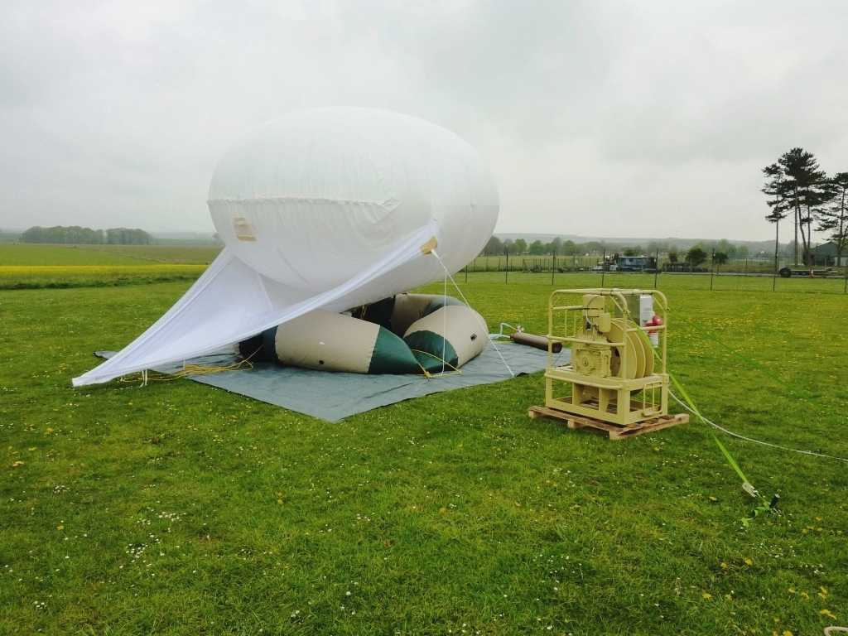
34m3 Desert Star Helikite + Helibase + Winch

Slide 17
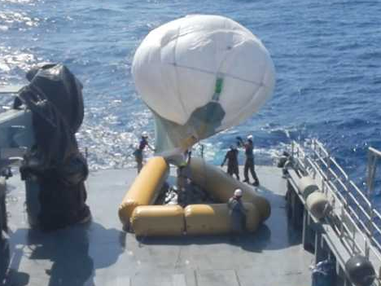
This 64m3 Desert Star Helikite is big enough to lift an ABSOLUTE system of up to 20Kg – thus NOT requiring RF-Over-Fibre.
64m3 DESERT STAR HELIKITE DEPLOYING AT SEA. This is straightforward and safe, but expensive, and not as quick and agile as preferred for ABSOLUTE.

Slide 18
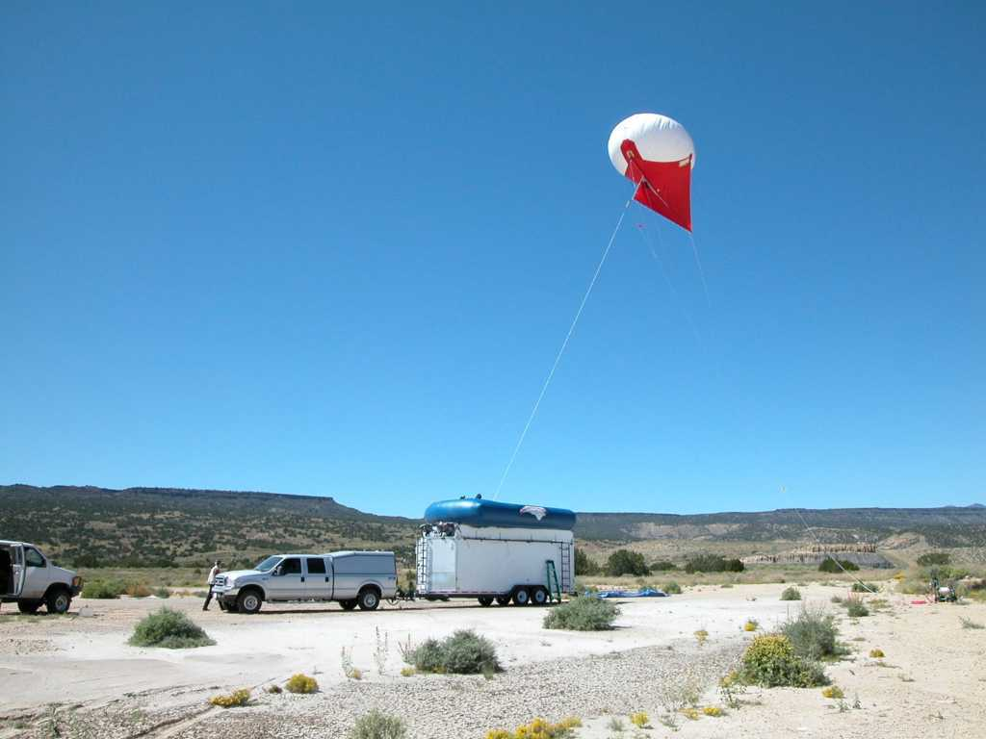
RF-Over-Fibre would allow Helikites in the 25m3 – 34m3 size range to be used
34m3 Skyhook Helikite for Sandia National Laboratories,
New Mexico desert.
Rapid-response military radio-relay station.
Helikite launches from top of custom trailer within 20 minutes.
Skyhook Helikites of any size can be safely inflated, launched, retrieved and deflated by only one or two people in all weathers, night and day.

Slide 19
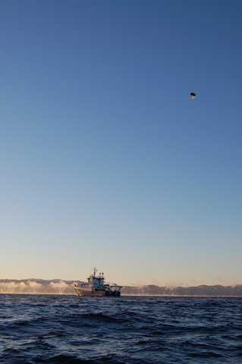
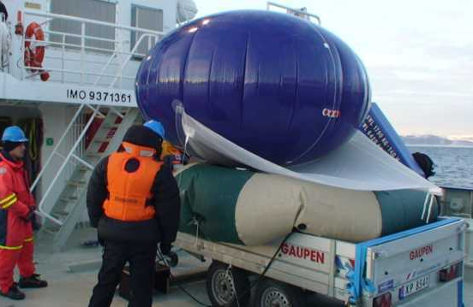
SMALLER HELIKITES ARE EASIER AND SAFER TO DEPLOY FROM ANY PLATFORM AND IN ALL CONDITIONS.
10m3 Desert Star Helikite
6m3 Skyhook Helikite
CONCLUSION: REDUCING WEIGHT IS ALWAYS WORTHWHILE!

Slide 20
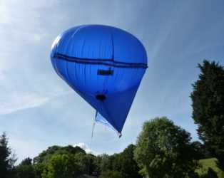
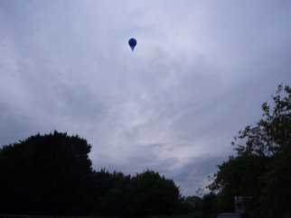
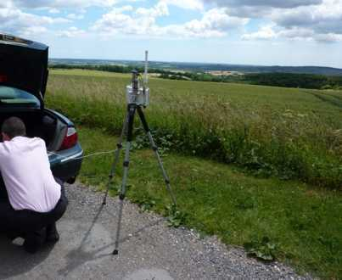
Concept Demonstrator Rajant Airborne MANET Video Relay. 7th July 2010 7 cu metre Helikite at 400ft + Rajant ME2 (2.4GHz/600mW) sent IP video at 5 frames/sec out to 6 miles. The same radio system flown on a helicopter has sent the video 14 miles.

Slide 21
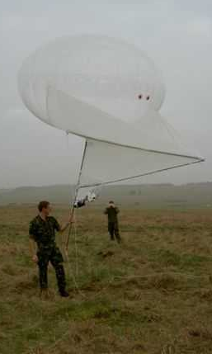
Small and handy
7 cubic metre, low-visibility, all-weather, Stealth Helikite Would RF-Over-Fibre technology allow this in the future?
UK INFANTRY TRIALS
US NETWORK-CENTRIC MANET TRIALS

Slide 22
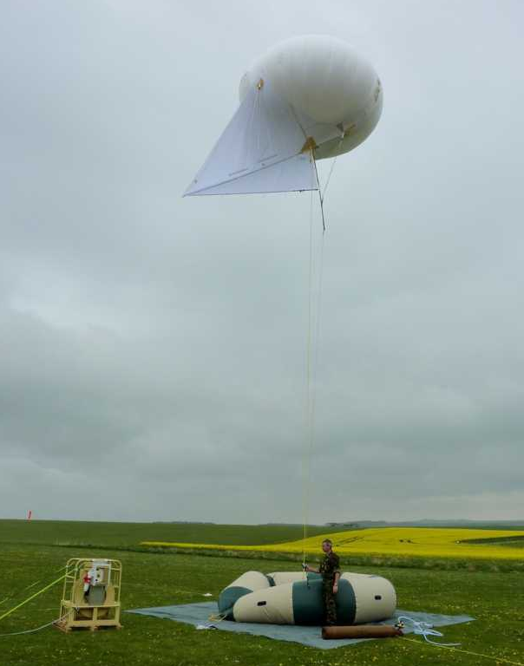
34 CUBIC METRE DESERT STAR HELIKITE
Tough, double-lined construction.
Carries a 10Kg 25x Zoom EO/IR gyro camera for the British Army in Afghanistan.
It can also lift a 4Kg MANET radio to 5000ft from ship or shore.
Twin-drum electric or motor winch. Remote controlled. Reliably deploys Dyneema flying line + fibre-optic .
Helibase for easy inflation and launch.

Slide 23
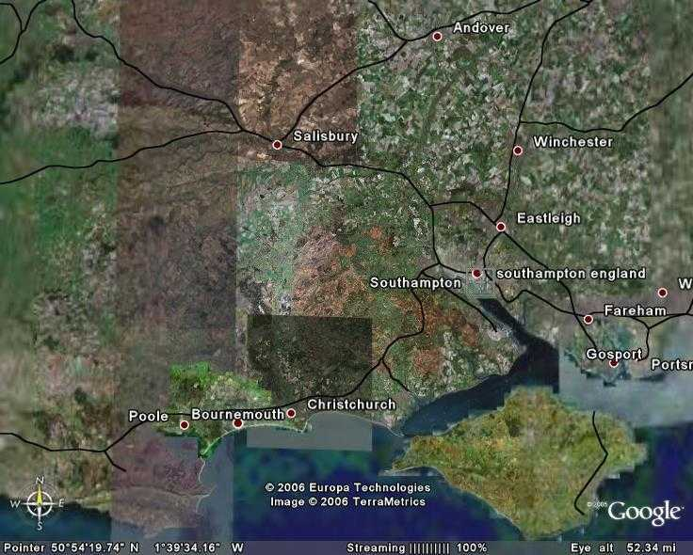
3.3 CU METRE SKYHOOK HELIKITE USED FOR EXTENSION OF RADIO COMMS
Maj. David Warden - Royal Signals. M.Sc. Project: “Use of Aerostats for range extension of mobile radio communications.” Cranfield July 2004.
114 cubic foot Skyhook Helikite +Coax + Dipole gave 0.05 Watts at 40 metres altitude.
Good line-of-site COMMS to HTZ Warfare Model
Blandford Model predicts most of Hants/Dorset/Wilts/ covered (40 mile radius) with 2x radio-relays using 3 Watts at 630 feet altitude.
10 miles
BLANDFORD
DAMERHAM

Slide 24
July 2010 US Army Trials. White Sands Test Range. 2Kg Rifleman Radio. 2 Watt. MANET
50 Km radius from an aerostat at 700ft.
50 km

Slide 25
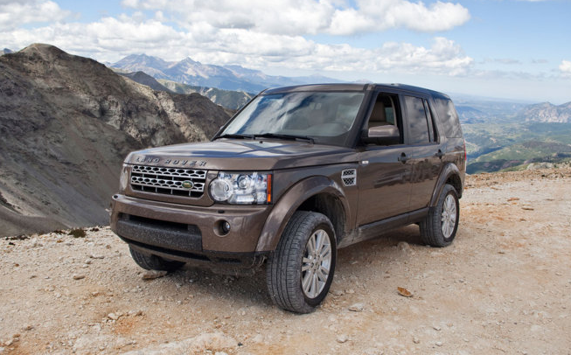
LOGISTICS FOOTPRINT USING 34m3 OR SMALLER HELIKITES
Four wheel drive will be needed in case the best launch site is off-road.
A Land Rover or pick-up truck can carry everything including helium cylinders, winch, Helibase, ground-anchors, Helikite, electronics, batteries, ground-station etc. Anybody with a normal car drivers licence can drive a Land Rover. It is also very easy to fix a Land Rover anywhere, and spares are no problem.

Slide 26
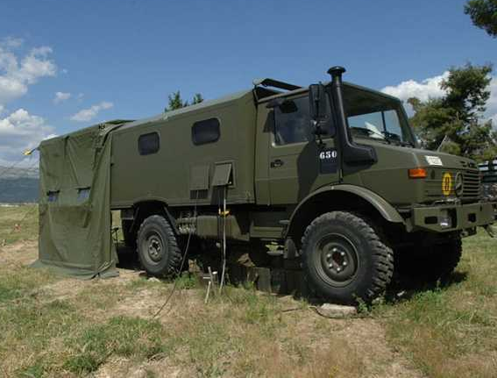
LOGISTICS FOOTPRINT USING 64m3 OR LARGER HELIKITES
The extra weight of helium cylinders, larger winch, larger Helibase etc is likely to require the use of an army radio truck or similar. This may need qualified HGV drivers to drive and repairs are going to be difficult to carry out in many places.

Slide 27
CONCLUSION:
Smaller payload makes deployment faster, easier, more reliable, more practical and versatile.

Slide 28
ALLSOPP HELIKITES LIMITED
Unit 2, Fordingbridge Business Park, Ashford Road, Fordingbridge, Hampshire, SP6 1BD, England.
Tel: +44 (0)1425 654967
www.allsopphelikites.com

